Slide 1
IRC Weight Measurement
International Rating Certificate

Slide 2
Weighing
A brief overview of weighing for IRC and IRC Endorsed

Slide 3
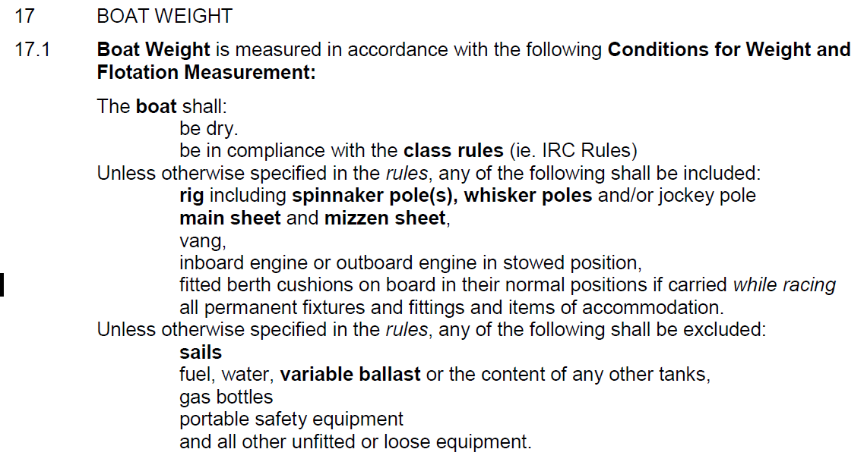
Boat Weight
IRC Rule 17 defines:
Notes:
[Read Boat Weight Definition]

Slide 4
Weighing Condition
Water and holding tanks pumped dry
Water ballast tanks empty
Fuel is acceptable to deduct known weight from the gross weight.
Only loose items on-board:
fitted (but not necessarily fixed) bunk cushions
loose bunk boards
floor boards and washboards
spinnaker pole(s).
Notes:
Water and holding tanks should be pumped dry. From 2013, it has been clarified that water ballast tanks shall also be empty. Fuel is more difficult and it is acceptable to deduct a known weight of fuel from the gross weight. If doing the latter, 2 means of estimating quantity should be sought. For instance, a fuel gauge, and a measurement of tank volume together with either dipping the tank or a sight glass. Diesel has a specific gravity of 0.85, ie 1 litre weighs 0.85 kg.
The only loose items aboard should now be fitted (but not necessarily fixed) bunk cushions, loose bunk boards, floor boards and washboards, and spinnaker pole(s). Make a note of the number of loose cushions for our records. Note also the number, identification if possible, and size of batteries (if there are an unusually large number of batteries, check that they are actually connected!), and the quantity of internal ballast. In the case of production boats any deviations from standard, eg addition/removal of furniture such as doors and tables should also be noted.

Slide 5
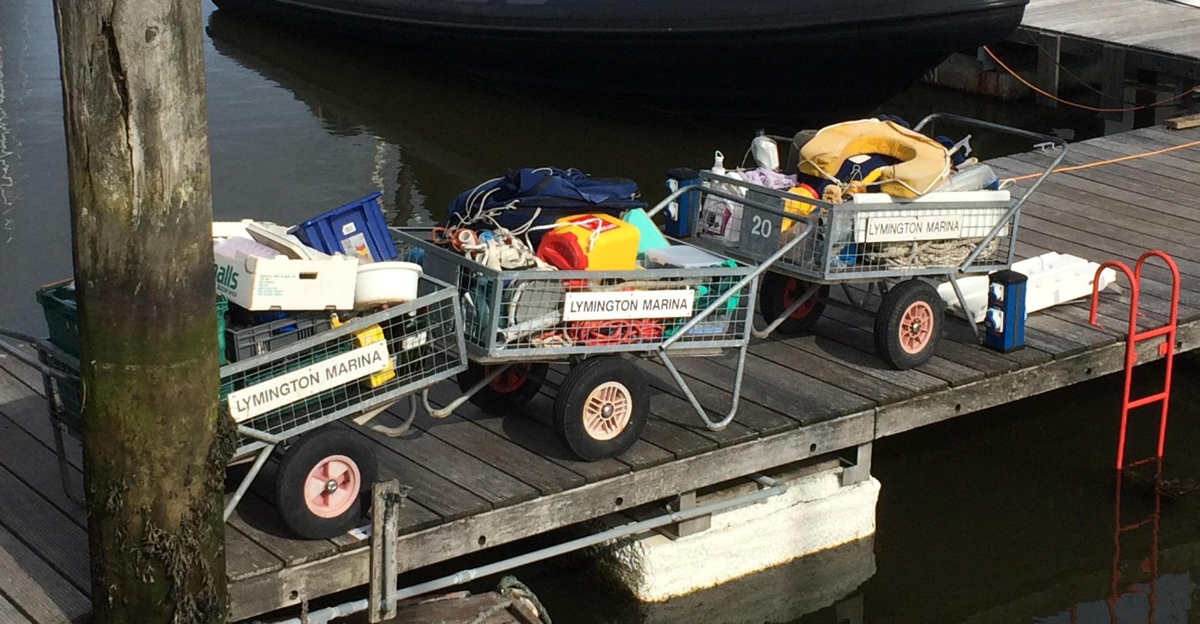
Weighing Condition

Slide 6
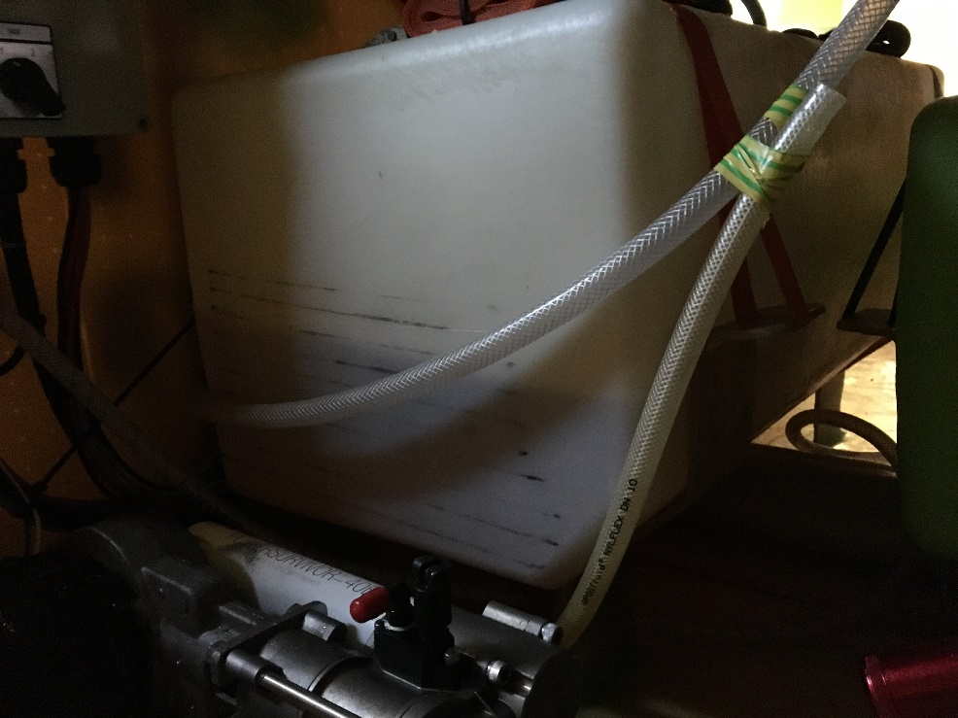
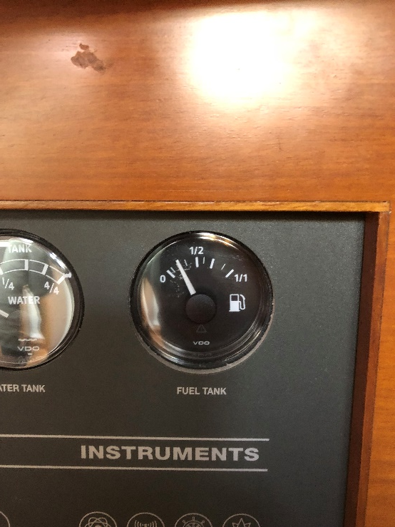
Fuel Tanks
Only Use Gauges as Last Resort
Notes:
Check for Multiple Tanks – Swan 45 Example
Only use Gauges as Last Resort
Note – That a broken electrical connection will show as 0 on gauge
Measure tank shape – Plastic tanks you can see fluid in tank – Shining a torch behind or into the tank can make it clearer

Slide 7
Fuel Tanks
Metal Tanks – Measure shape and if possible dip the tank – Have a cheap tape measure + kitchen roll in your bag.

Slide 8
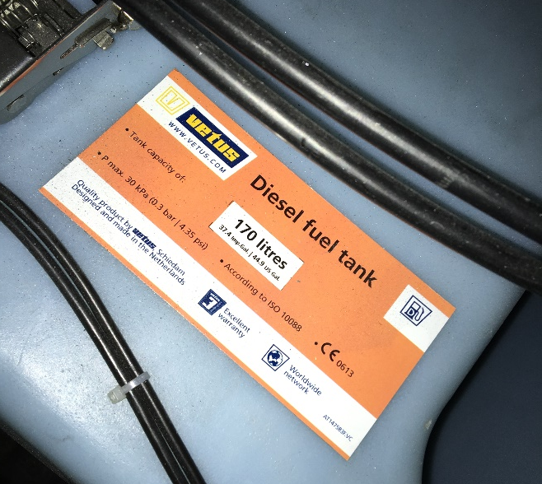
Tank Capacity
Most non-custom tanks should be CE Marked including the capacity

Slide 9
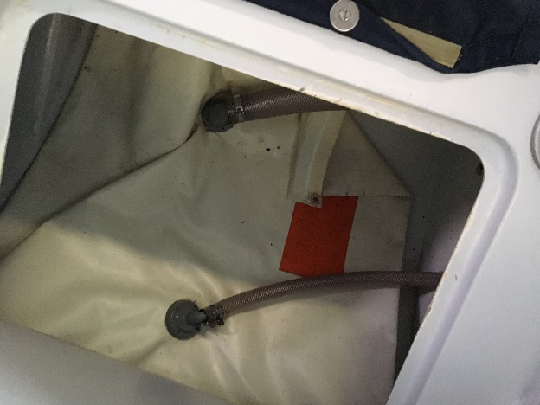
Water & Holding Tanks
Have a good check of boat for multiple tanks – Trace pipework through from sinks & toilet.
Check by;
Visual Inspection
Running taps –Don’t forget hot & cold
Open up inspection hatches, plates etc

Slide 10
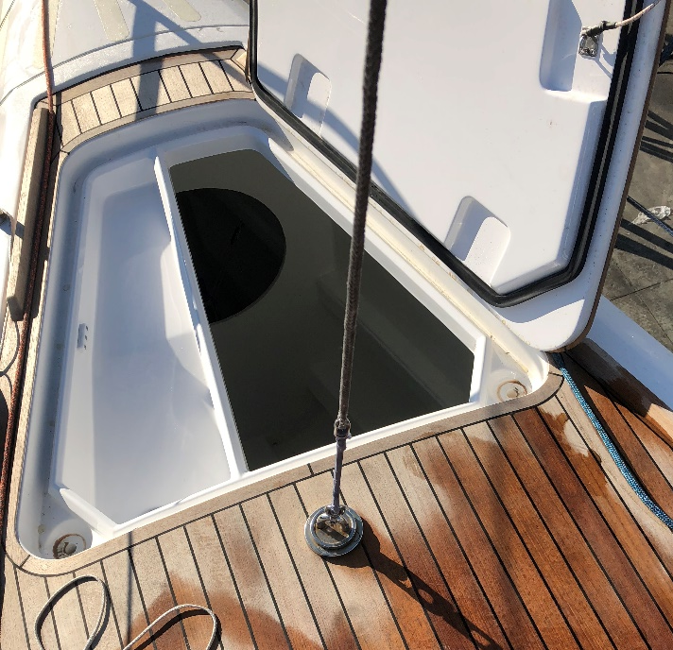
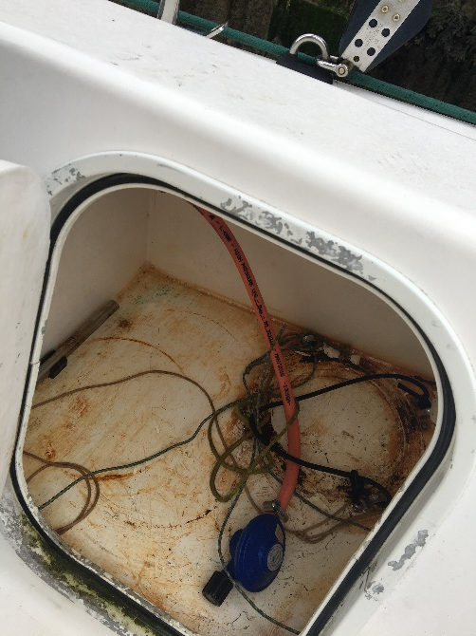
Lockers
Check All Lockers – Both Above & Below Decks
Don’t Forget Anchor & Gas Lockers

Slide 11
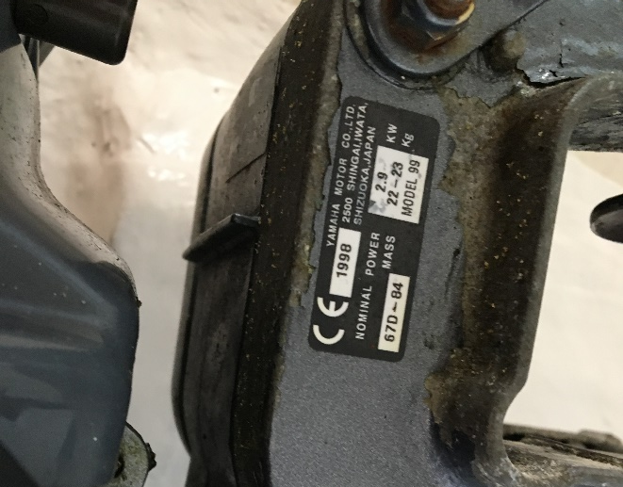
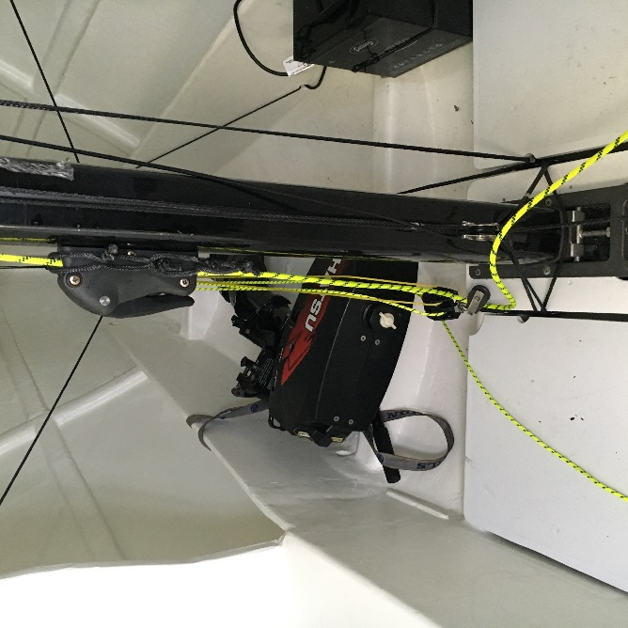
Outboard Engines
Stored in Normal Position Whilst Racing
Note & photograph location
Notes:
Don’t forget to deduct fuel
Useful to record serial number to check for engine changes in the future

Slide 12
Weighing Condition
WATCH FOR (not exhaustive):
Bilges full of water.
Mainsail on the boom.
Anchors 'forgotten' under bunks.
Water fuel and holding tanks. Watch for second (and third and fourth….!) water tanks.
Chart tables full of charts and other rubbish.
Portable electronic equipment (laptop computers etc.)
Safety gear: horseshoe rings and Dan buoys on the transom.
Gas bottles (and spares!).
Fire extinguishers.
Are removable cockpit boxes on board?
Fenders and mooring lines as the boat is lifted.
Running rigging shall be slack.
Notes:
There are a number of traps the measurer can fall into.
It is absolutely essential that the boat is EMPTY (see measurement condition in IRC rule 17). The measurer must be pedantic, inspecting every locker, lifting every board, and insisting on the removal of EVERYTHING, down to the toilet rolls.
Among things to watch for are:
Bilges full of water.
Mainsail on the boom.
Anchors 'forgotten' under bunks.
Water fuel and holding tanks. Watch for second (and third and fourth….!) water tanks.
Chart tables full of charts and other rubbish.
Portable electronic equipment (laptop computers etc.)
Safety gear: horseshoe rings and Dan buoys on the transom.
Gas bottles (and spares!).
Fire extinguishers.
Are removable cockpit boxes on board?
Fenders and mooring lines as the boat is lifted.
Running rigging shall be slack.
Do not treat the above as exhaustive. Vigilance is the only answer.

Slide 13
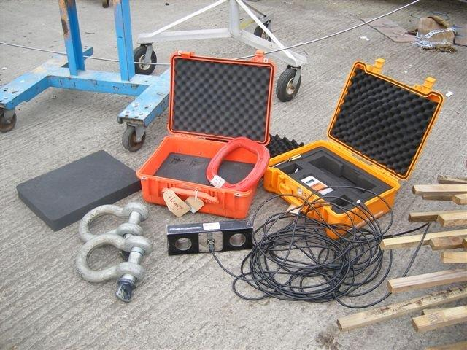
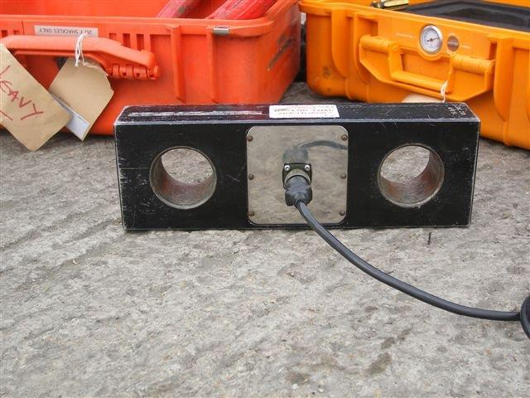
Loadcells
Only RORC or RORC Approved Loadcells To Be Used.

Slide 14
Weighing Equipment
Weighing can occasionally results in anomalous figures. In most cases, this can be ascribed to inadequate weighing equipment.
CHECK CAREFULLY:
Strops and spreader bars – Check spreader bars + boat won’t overload loadcell
Shackles are correct strength
Shackles sized to match to the holes in the load cell to minimise freedom of movement
Check load cell battery level – If rechargeable make sure its charged
Temperature – Don’t expose the loadcell to large temperature changes – Cars / Hotels Etc
Notes:
The weight of boats causes possibly the most dispute of any measurement; while an apparently simple procedure, it occasionally results in wildly anomalous figures. In most cases, this can be ascribed to inadequate weighing equipment.
The shackles for the load cells have to be carefully sized, not only for strength, but for match to the holes in the load cell. A minimum freedom of movement has to be allowed, otherwise any torsion or twist when lifting will be directly transmitted into the load cell, giving a potentially erroneous answer. If too much freedom of movement is given, the measurement can also be wrong.
Load cell battery level is also important. If in doubt, change or charge the batteries
When noting the weight of strops etc, read the sign (+ or -) on the display. Negative values are quite possible if the display has not been zeroed before use.

Slide 15
Loadcells
Your responsibilities on the job
Installation of the loadcell with the lifting gear
Ensure the loadcell is handled correctly and installed correctly
Keep all cables disconnected as long as possible
Once connected, the cable and display unit should not leave your hands
The final responsibility lies with the yard/contractor, but if you see something which concerns you, tell them
The shackles are just as important as the loadcell:

Slide 16
Weighing Conditions
Noticeable effects:
Wind and Rain:
Weighing carried out in:
Dry weather
Local wind <10 knots
Beware of wet decks and topsides
Measurers discretion to abandon for consistency of measurement – Yard / skippers call to abandon for safety
Temperature changes watch out during long measurement sessions
Notes:
Wind and rain can have noticeable effects. Wind will also always increase the figure read. Ideally, weighing should be carried out in light winds, preferably 10 knots or less and dry weather. It is recognised however that this will often not be practical. With care, satisfactory results can be achieved in stronger winds.
Directly, wet decks and topsides can hold significant quantities of water.
It is also sometimes possible to find a sheltered location. It is therefore left entirely to the discretion of measurers when to abandon a weighing because of conditions. Measurers must always report actual conditions to the IRC Rating Authority.
The load cells can be susceptible to temperature changes, care should be taken to avoid large temperature changes prior to weighing i.e. storing in a warm office prior to weighing on a cold day or a cold (air conditioned) areas before weighing in hot climates. When arriving on site open up the load cell and set up to allow as much acclimatisation as possible.

Slide 17
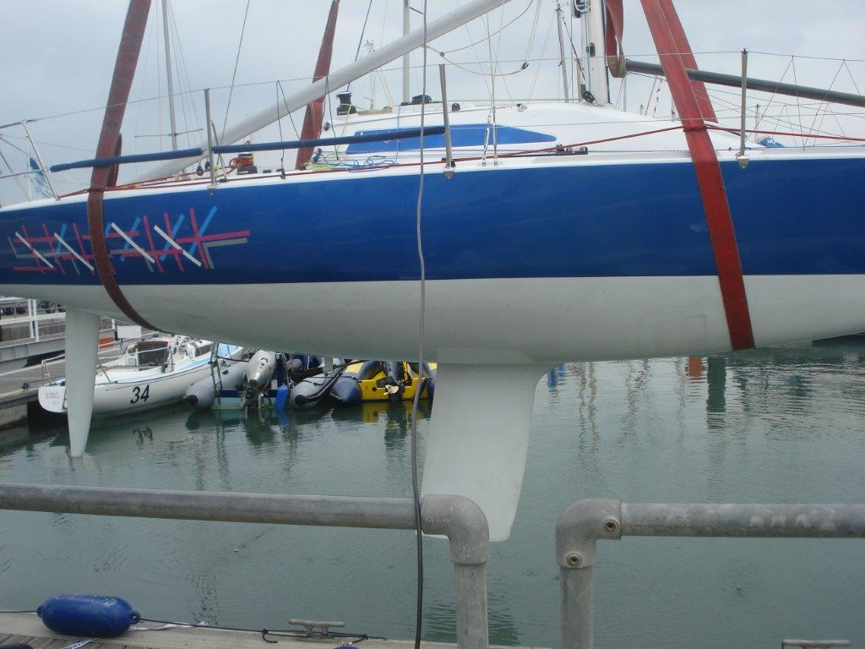
Weighing

Slide 18
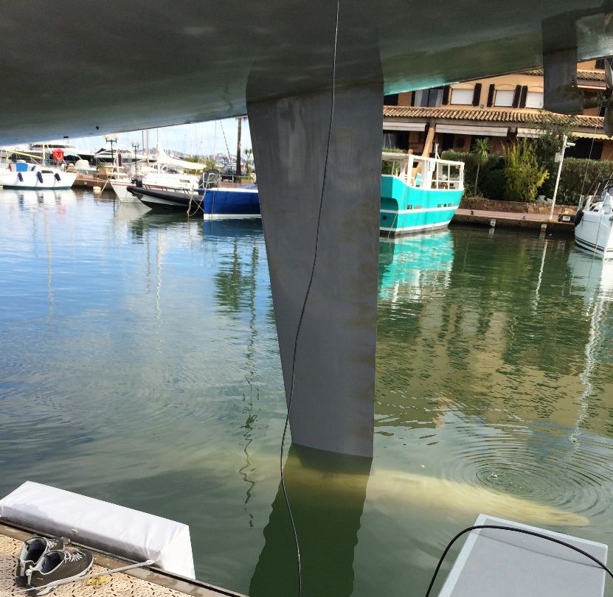
Bulb Weight
Where possible submit the weight with the bulb just immersed.

Slide 19
Weighing Method
Single point lifting beneath the load cell
Either:
boat’s built in lifting point
or straps around the hull with or without a lifting frame/spreader bars.
Help but don’t position strops - leave lifting the boat on the prop or impellor to the yard & owner
Don’t forget to tare off the lifting gear
Pre-Wet Strops before zero
Notes:
The IRC Rating Authority’s strongly preferred method of weighing is hanging the boat from a single point beneath a load cell. This may be either using a boat’s built in lifting point or straps around the hull with or without a lifting frame/spreader bars.
Having emptied the boat, the weight of lifting gear below the load cell (ie spreader bars, straps, shackles, etc.) must be found for deduction from the gross weight.
Unless using an internal centre lift point, if the boat is to be lifted from the water, the slings should first be immersed. On some load cells, this weight can be zeroed out. It is left to the measurer’s discretion whether he does this or notes the reading for later deduction.

Slide 20
Weighing Method
Boat weighed at least twice
All weight removed from the loads cell between 1st and 2nd weighing
If any significant difference (+/-10kg) is seen, STOP AND FIND THE PROBLEM.
Please do NOT ‘adjust’ the figures
Have a feel for expected weight – Review with owner if differences before dismantling strops
Notes:
The boat should now be weighed twice, with all weight removed from the load cell between weighings. If any significant (+/-10kg) difference is seen, STOP AND FIND THE PROBLEM.
Re-weigh the strops etc. to check finally that nothing has shifted. Again if any significant difference is seen STOP AND FIND THE PROBLEM.
Be rigorous in recording everything, and input all weights, notes and comments. Please do NOT 'adjust' the figures.

Slide 21
Weighing Report
Actual weather conditions
Quantity of fuel and water
Overhang measurements.
Quantity of internal ballast
The number of batteries on board.
What was on board and what was not
Cushions that were on board or not on board.
If removable cockpit boxes were on board or not.
Production boats: any deviations from standard, e.g addition/removal of furniture such as doors and tables
Notes:
It should be noted in the weighing report cushions that were on board or not on board and if removable cockpit boxes were on board or not. The number of batteries on board should also be noted.

Slide 22
Weighing Method
For very large boats (>30.5m) the Rating Authority may approve calculation of weight from freeboards
An alternative acceptable method is the use of 3 or 4 compression load cells to weigh the gross weight of the boat in a static cradle.
Currently weighing a boat hung in a travel lift rolled onto compression load cells is NOT an approved method of weighing.
ALL – The above are at the discretion of the Rating Authority not the yard or measurer.
Notes:
For very large boats for which weighing is impractical, generally longer than 30.5m or weighing in excess of 20 tonnes, the Rating Authority may approve calculation of weight from flotation freeboards and declaration of weight by the Rating Authority. The Rating Authority may delegate this task to the designer. If this approach is to be taken, the IRC Rating Authority must first be contacted to discuss the proposed method.
An alternative acceptable method is the use of 3 or 4 compression load cells to weigh the gross weight of the boat in a cradle. By then deducting the weight of the cradle, boat weight can be found. This method can produce good results, but is more susceptible to error by way of missing straps, and other equipment. It is also a composite measurement, with all the inherent possibilities for error. Good measurement practice is essential.
Currently weighing a boat hung in a travel lift rolled onto compression load cells is NOT an approved method of weighing. The Rating Authority is experimenting with a view in the future to permitting this method. To date however the results have not proved sufficiently reliable.

